Slide 1
Exploratory Data Analysis
Udemy Data-Set

Slide 2
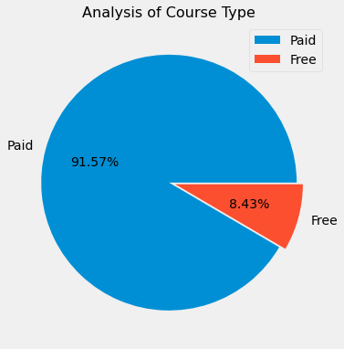
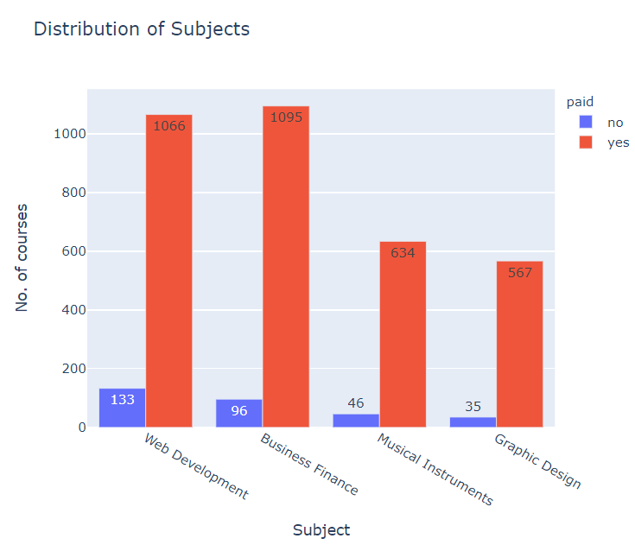
Courses Analysis
Most of the offered courses are paid.
Only 8.43% are Free Courses.
Authors prefer to get paid for the courses due to the time and resources they had invested.
High Concentration of Web Development and Business Finance courses
Least amount courses are under the Graphic Design.

Slide 3
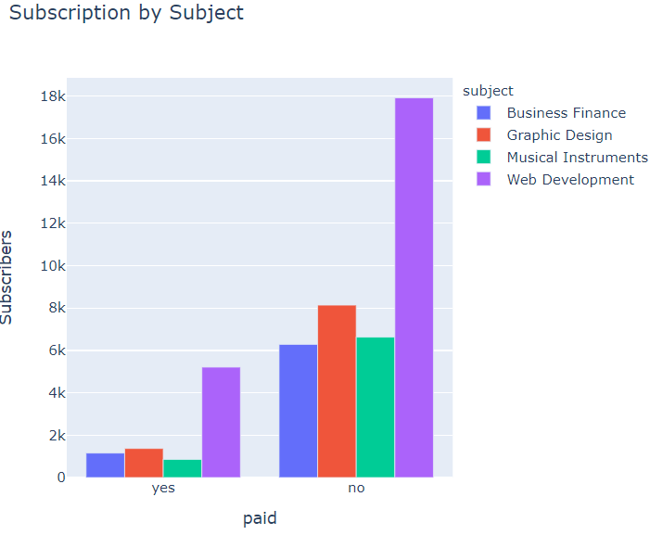
Subject Analysis
Users have a High subject preference towards Web Development
Graphic Design is the 2nd most Popular Courses followed by Business Finance
Musical Instruments have higher preference than Business Finance when it offered for free
Users Have High Preference for Web Development
Increasing more courses on Graphic Design would be profitable because of user preference
Despite Business Finance having a high concentration of courses. It is does not have popular by users.

Slide 4
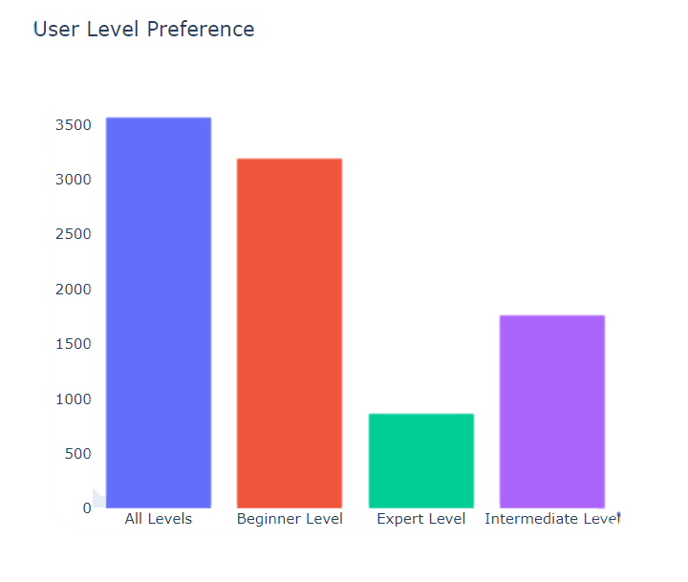
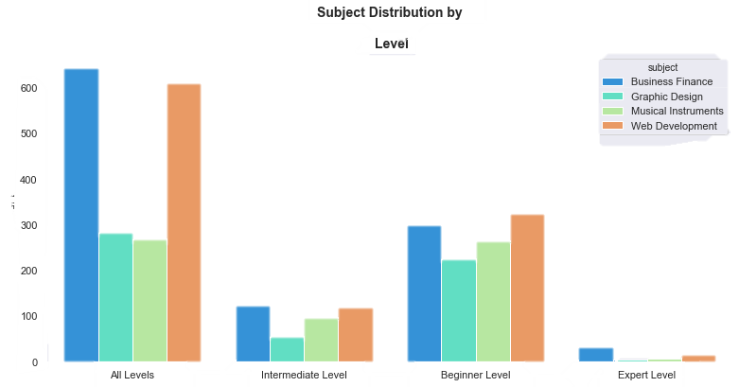
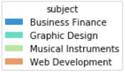
Regardless of the Subject there is high concentration on All level and Beginner level courses.
Graphic Design has higher preference in all level category.
Low concentration of Expert Level Courses compared to the Beginner and All Level courses .
No free courses on Expert Level
Users have preference over All levels and Beginner Category.

Slide 5
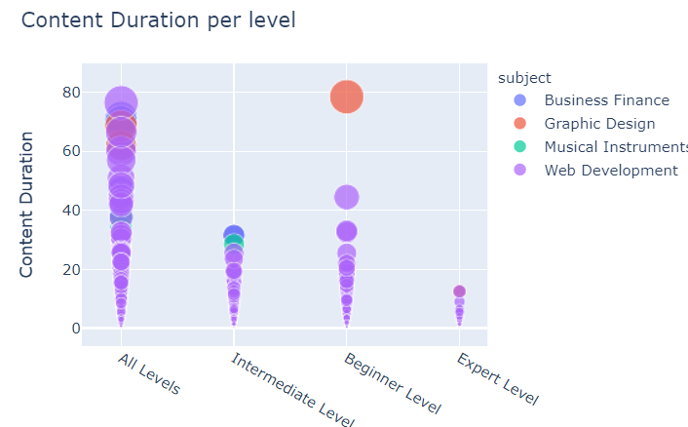
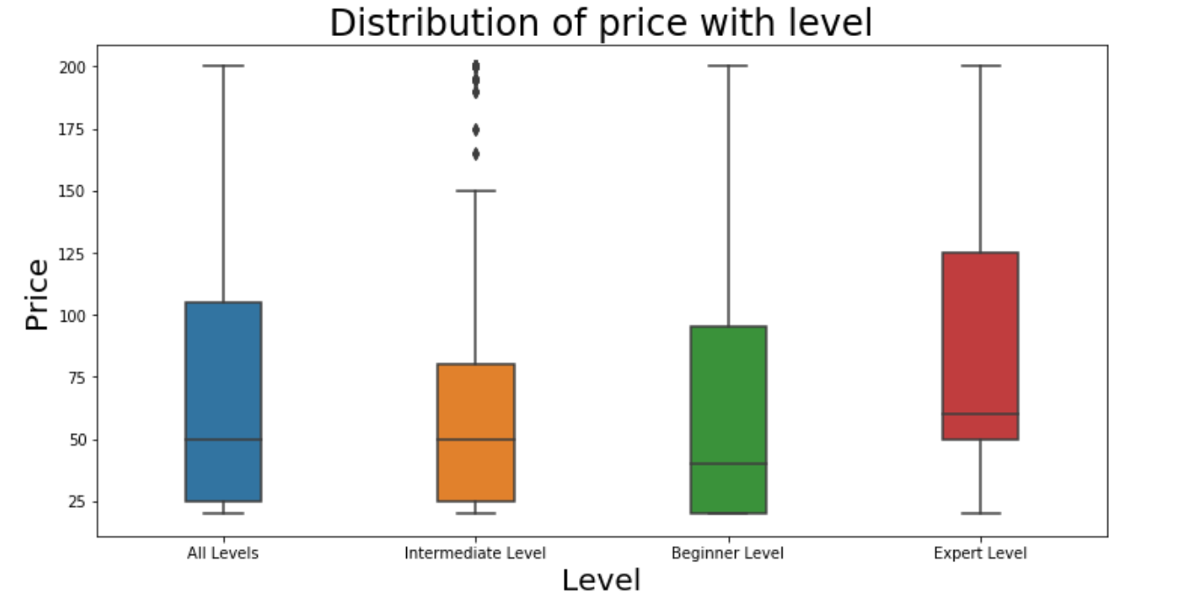
The Content Duration is high for beginner and all level category.
The price of the courses varied from $0 to $200.
Expert Level has the most concentration of high paid courses.
Starting price of the beginner level courses are least.

Slide 6
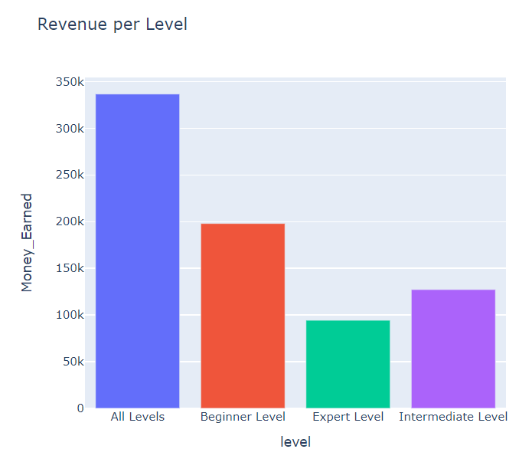
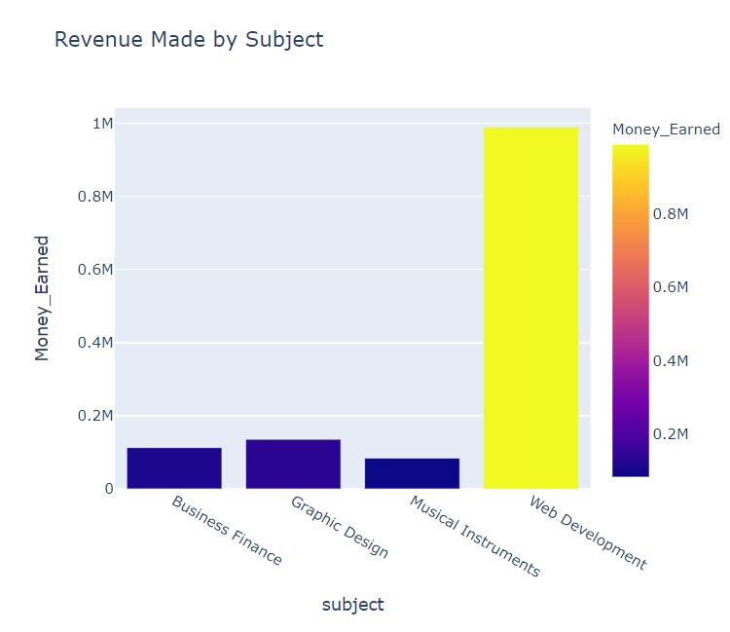

Slide 7
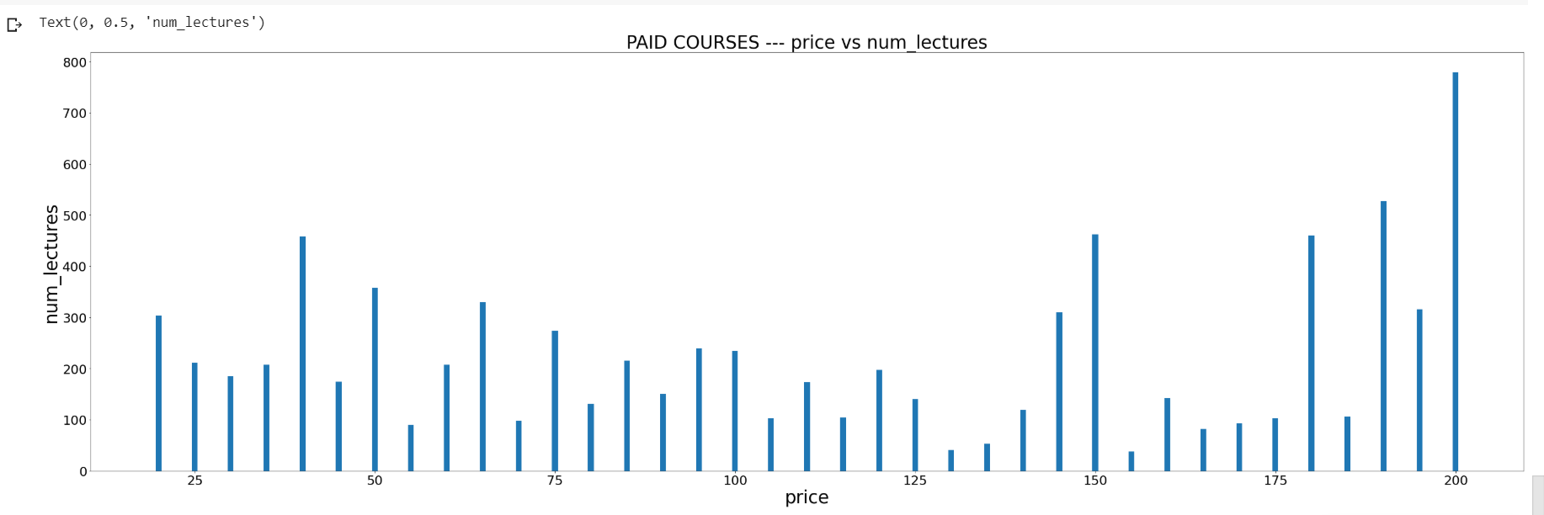
Higher concentration of review and subscribers on free courses
In Paid Category,
Highest paid courses have most lectures and Reviews

Slide 8
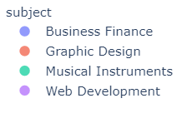
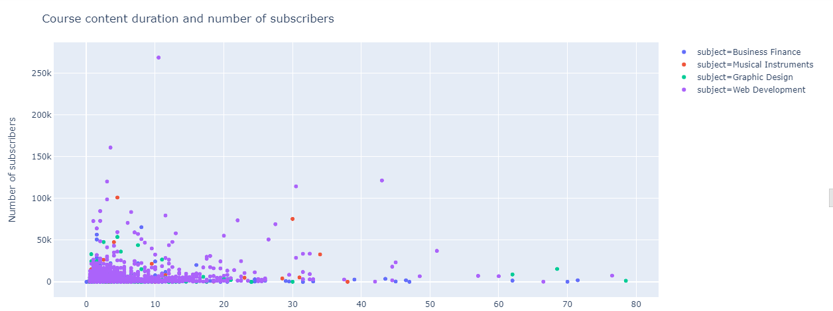
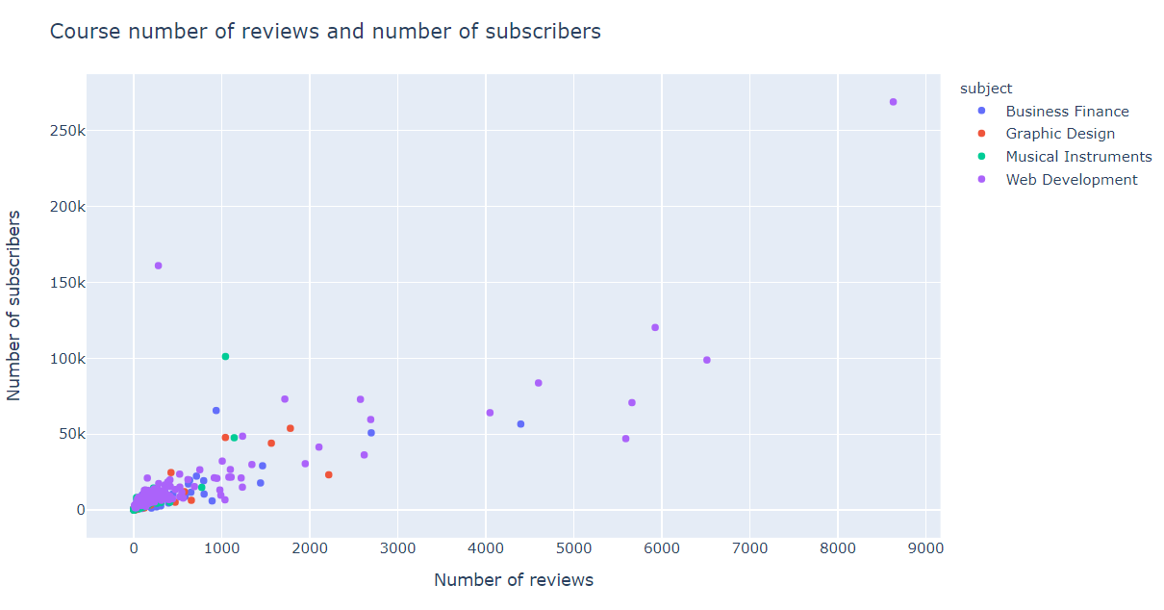

User Duration Preference
Most Users Prefer the courses to have less duration
There is a linear relation between Reviews and Subscribers

Slide 9
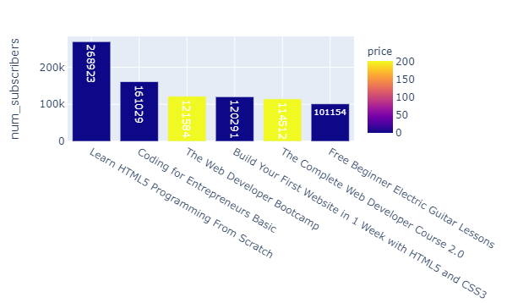
Popular Courses
The courses with highest subscription count are programming courses (5 out of 6). Out of the top 6 subscribed courses, 4 are free courses and 2 are paid courses(worth 200$).
By Subscription count, the top 5 courses are programming courses.
The most sought out courses are programming courses.
Some courses from subjects Business Finance, Graphic Design and Musical Instruments have zero subscribers but Web Development did not have any zero subscribed courses indicating the interest/demand for Web Development
The cost of top subscribed paid courses is 200$ from web development subject. It was also observed that paid courses have more engagement (in terms of reviews) when compared to free courses.

Slide 10
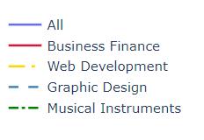
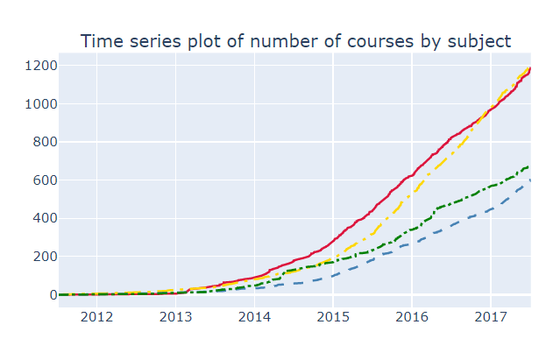
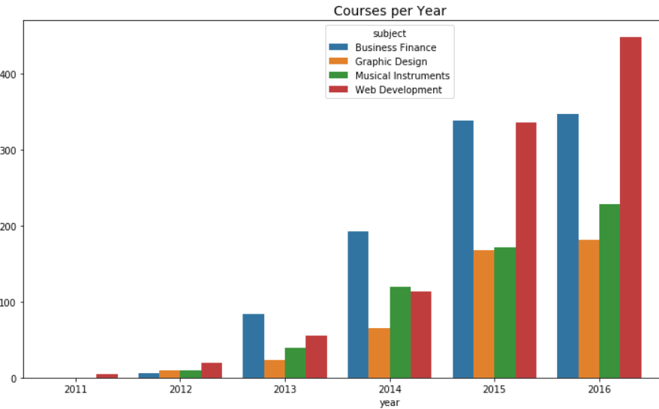
Time Series Analysis
The amount of Web Development courses being upload has taken a huge leap in the year 2015.
Web Development became the most uploaded course in 2016 surpassing Business Finance.
Web seems to a slight decline in 2014

Slide 11
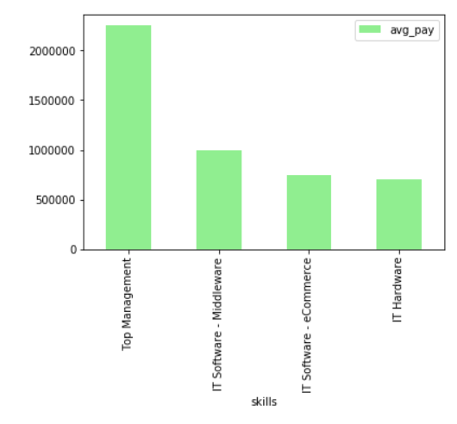
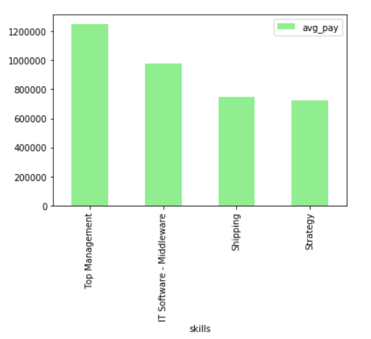
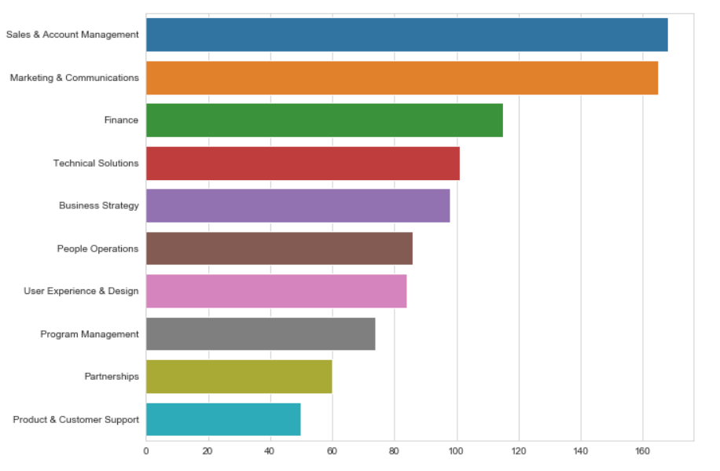
2015
(Naukri Job posting)
We notice that the average salary on Top Management which usually takes care business has reduced.
IT sector has shown a steady growth between the years.
2016
(Google job skill Dataset)
High Demand for Business Finance Skill. Hence more concentration of courses by industrial experts. Followed by the Technical Skillset

Slide 12
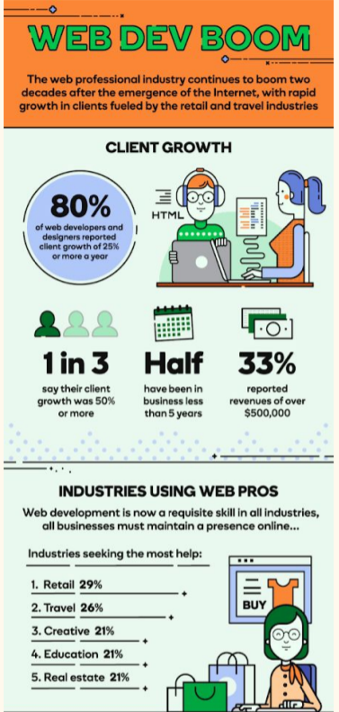
Godaddy
Tech City UK website
Web development and Business have to work hand in hand because of the growing the Digital Economy
We observe that for the professional to keep up with the evolving trend and for developers to Improve their skillset Online Training courses are advised.
This shows us the reason for increase in online courses of Business Finance and Web Development
According to the Article in London:
45% increase Web Developers from 2015/16 to 2016/17.
Occupation relies heavily on programming languages like Javascript3, and HTML.
This also explains the User preference on Top courses on Udemy.
Experienced fall in web development jobs of 47% 2012/13 to 2013/14.
This explains the Web Dev decline in 2014

Slide 13
Thank You!
Our Team:
Tamizhiniyan S R
Ayush Gaur
Ayush Paul
Akhila Reddy
Divya Tata
Guna Gokul
Sanna Showkat
S.Madhu priyanka eswari
Hrithvik Atluri
Shreya Dwivedi
Shaik Irfan Ameer
Our Mentors: Shantanu Shubham and Prakhar Shrivastava
( ACM Student Chapter, IIT (ISM))

